Slide 1
Implementing a Students of Color Group at a Predominantly White Institution (PWI)
Jason Axford, M.A., LMHC
Staff Clinician
University of South Florida Counseling Center
Notes:
Title Slide

Slide 2
Acknowledgement
Some information contained in this presentation has been adapted from materials prepared by the USF Counseling Center’s Committee on Diversity and Inclusion (CODI).

Slide 3
Agenda
Intro/Beginning – 10 minutes
USF Context – 15 minutes
Race, Racism, Racial Healing – 15 minutes
Group Therapy with People of Color – 15 minutes
My Journey – 25 minutes
Q & A – 10 minutes

Slide 4
Housekeeping …
Lots of information; going to jump right in!
4 students of color identified populations, however, there’s others
Similarities/Differences/Nuances
3 experiential exercises – 1 large group and 2 pre-selected small group
Q & A – relative to your college (location, size, status, resources)
Follow up material and resources available (upon request)
I’m available after presentation ☺

Slide 5
Learning Objectives
Discuss the impact of institutional racism on students of color and how this impacts persistence towards graduation
Utilize evidence-based practices to implement a students of color group.
Discuss the challenges of different types of universities (size, location, private/public etc.) to starting a group for students of color

Slide 6
Additional Considerations …
Your individual and cultural diversity factors
How your Counseling Center and its partners take these factors into consideration while providing clinical services

Slide 7
First Things First …
Cultural Competence Framework
Cultural Competence - “loosely defined as the ability to understand, appreciate and interact positively with people from cultures or belief systems different from one's own”
University Counseling Centers are challenged to thoughtfully consider the identities and lived experiences of our student clients when we:
Conceptualize concerns
Recommend treatment
Develop and maintain rapport
Provide culturally congruent clinical services

Slide 8
First Things First … Intersectionality Framework
The impact of intersecting identities on the lived experience of a person
Intersecting identities can include
Socioeconomic Status and Class Race and Ethnicity
Sexual orientation Gender
Religion Immigration status
Ability status National origin
Age And many more…
Practical Example – Comparing two individuals
Notes:
Intersectionality is a helpful concept in understanding the actual lived experience of individuals rather than generalizing based off membership in a particular group
Practical Example - How might the life of an affluent, white, Christian, American female student born in the United States differ from the life of a working class, heterosexual, Caribbean-born, Christian, immigrant female student?
For added complexity, what happens if these two people live in Birmingham, Alabama? How might that be different if one of them lived in New York City, New York?

Slide 9
USF Students of Color
University of South Florida – Tampa Campus

Slide 10
Overview: USF Counseling Center – Tampa Campus
Helicopter View (Campus)
Overview … of USF Counseling Center – 40000+ students, diverse, urban, non-traditional, state school etc.
On the Ground (Counseling Center)
35 clinicians, robust group therapy, short-term model, climate and culture, framework, competence etc.
First Person Control (Counselor/Group Leader)
Counselor racial identity, bias, mentorship, racial microaggression, counter spaces liberation psychology, etc.

Slide 11
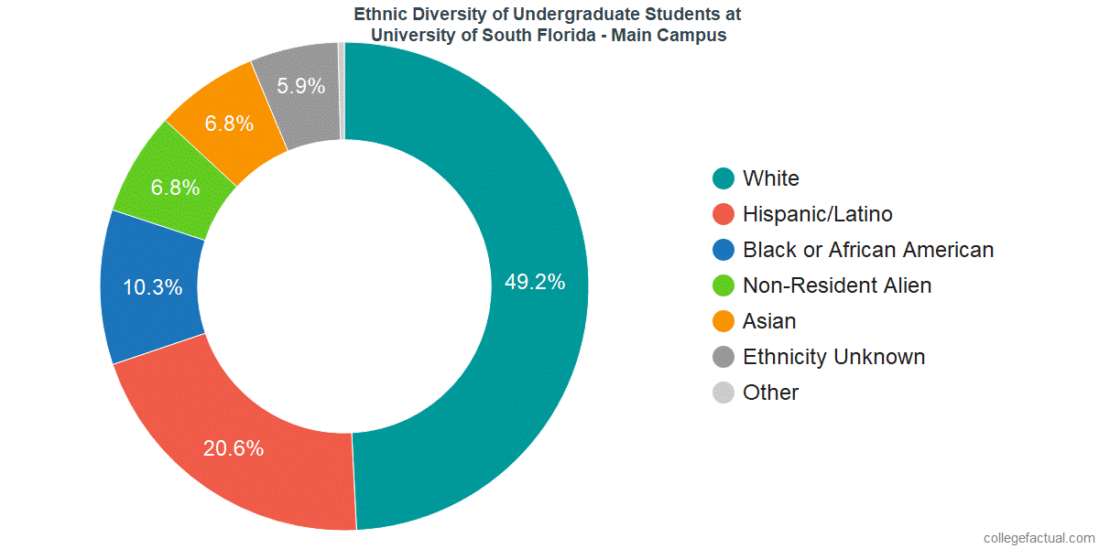
Ethnic Diversity among USF Tampa Students
Notes:
As the largest group of students are White, and since a portion of the non-resident alien and ethnicity unknown categories are students that identify as White (making it more than 50%), USF is considered a PWI – Predominately White Institution. However, USF ranks number 1 in the state of Florida for the highest percentage of students identifying as non-white.

Slide 12
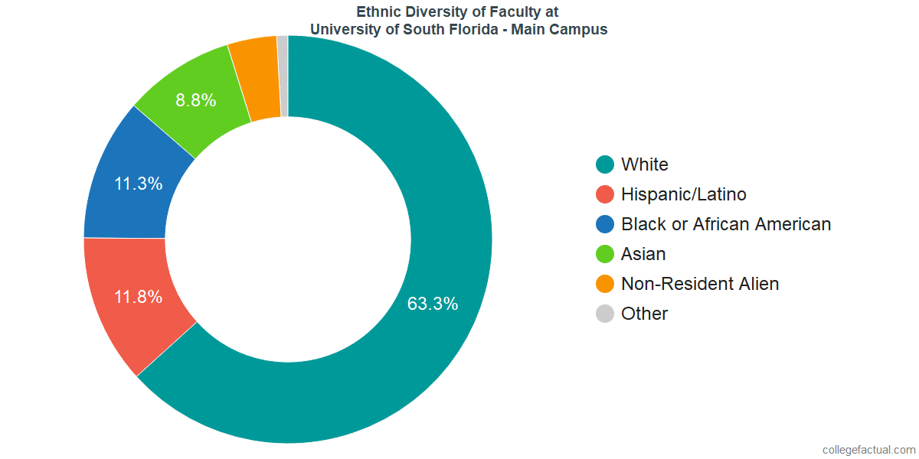
Ethnic Diversity among USF Faculty
Notes:
Contrasting the diversity of faculty to student body, USF does not have the same ratio of non-white representation among its faculty

Slide 13
USF Tampa Campus Resources
Office of Multicultural Affairs
Provides programming specifically for racial and ethnic minority students as well as other culturally diverse groups
https://www.usf.edu/student-affairs/multicultural-affairs/
Student Organizations
Multiple student groups related to Arab/Middle Eastern, Asian/Pacific Islander, Black/African, Latinx, Caribbean, and intersectional student organizations
https://www.usf.edu/student-affairs/multicultural-affairs/organizations/multicultural-community.aspx
Greek Life
Fraternities and sororities with historically African American (Pan-Hellenic) or Asian, Middle Eastern, Latino backgrounds (Multicultural Greek Council)
https://www.usf.edu/student-affairs/involvement/fraternity-and-sorority-life/about/councils.aspx
Presidential Advisory Committees
Status of Latinos and Committee on Black Affairs
https://www.usf.edu/diversity/presidential-advisory/

Slide 14
Race, Ethnicity, Racism, and Racial Healing

Slide 15
Race and Ethnicity
are
Social Constructs
based on
Phenotypic Expression
and are given
Subjective Meaning
Differential Treatment & Shared Identity
through
Notes:
Social constructs – there are no specific biological distinctions between racial groups, and the differences within a group are greater than between groups
Phenotypic expression is how our genes present in our physical characteristics. Indicators for race and ethnicity have included things like skin, hair, and eye color as well as physical features associated with specific groups such as eye shape
Subjective meaning – the value and conceptions (including misconceptions) placed on race and ethnicity is subjectively determined
Differential treatment – bias toward and against different groups, includes overt, covert and institutional racism
Shared identity – collective group identity, common cultural beliefs, values, and practices

Slide 16
Stress … It’s part of LIFE, however,
Race-Related Stress:
Race-related stress can be described as the psychological or emotional distress that an individual or group of people experience as a result of being a target of racial discriminatory acts. Racial discrimination is multidimensional and often occurs on three different levels - individual, institutional, and cultural.
The effects of racism have the potential to negatively impact every aspect of a student of color’s life.
Self-esteem, body image, and self-confidence
Fair treatment in courses, on-campus housing, employment
Internships, professional networking, and job opportunities
Social connection, romantic relationships & feelings of belonging
Student loan debt, scholarship opportunities, graduation rates
Notes:
Self-explanatory slide

Slide 17
Stress … It’s a part of LIFE …
Buffers to Race Related Stress
Having pride in one’s racial and ethnic identity
Connecting to a supportive community
Having faculty and staff serve as mentors and role models, particularly faculty and staff of color
Having other acknowledge and validate the impact of racism in student of color’s everyday life
Knowledge of effective strategies for navigating predominately white institutions
Well-developed healthy coping skills
Notes:
Self-explanatory slide

Slide 18
Mentoring African American College Students
Benefits of Mentoring
Formal Mentoring
Informal Mentoring
(Sinanan, 2016)
Notes:
Benefits – Was prominent in ancient Africa with kinship systems and rites of passage initiations instituted to guide youth in learning and behaving.
Formal – Structured mechanism and organizationally managed; mentee and mentor paired by the college. BFSA Mentorship program.
Informal – offers mentee less structure, more casual relationship. Faculty step in and informally mentor. PWI faculty realize the need and step up informally.

Slide 19
Racial Cohesion on Campus …
Racial Cohesion & Dissonance
College Contexts
Black College Students & Achievement
Psychosocial Adjustment & Racial Identity in College
School & Civic Engagement
Stress & Coping
(Bentley-Edwards et.al, 2015)
Notes:
Racial – examine racialized experience and dissonance beyond inward appraisals. Racial cohesion is a construct that describes how racial identity, behaviors, relationships, interests, and/or agency regarding one’s own racial group coalesce.
College – Black students contend with new and often racially challenging educational environments.
Achievement – Mixed findings; Black students attending PWIs experience less educational satisfaction and attrition rates more than one and a half times White counterparts. HBCUs provide more congruent cultural spaces resulting in more motivation.
Psychosocial – Appears to enhanced at HBCUs; trend towards holding more African-centered insights relating to history and culture.
Engagement – Participation in community-based activities and social commitment results in greater academic achievement, experience and overall adjustment.
Stress/Coping – Conflict within particular social environment. Stressful event or context can be perceived as either threatening or challenging.

Slide 20
Latinx Students and Racism
The Impact of Race and Racial Microaggressions
Campus Environment
Socio-cultural Factors
Involvement Factors
Development of Counter-Spaces
(Robertson et.al, 2016)
Notes:
Racism/Microaggressions – Blatant racism and subtle racial microaggressions emerge in racially assaultive remarks. Also, might present as stares/glances/put down/back-handed remarks/racist jokes/stressful confrontation.
Environment – Ideal is: inclusion of students/faculty/administrators, curriculum emphasizing historical and current experiences, support programs for recruitment, retention, graduation, mission that reinforces institution’s commitment to diversity/pluralism.
Socio-cultural – ethnic identity, immigrant status, gender roles, community orientation, and religion determines adjustment and retention. Latinx thrive at PWIs when adjusted socially.
Involvement – Faculty student interaction, mentorship, student organization participation.
Counter-Spaces – spaces or areas on PWI campus where Latinx students carve out in order to preserve their culture and develop a sense of belonging.

Slide 21
Know Your Racial Identity

Slide 22
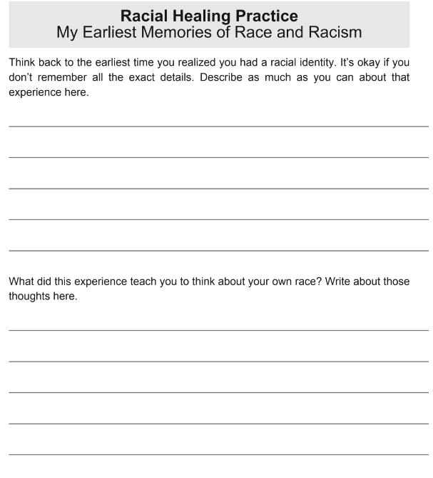

Slide 23
(Singh, 2019)

Slide 24
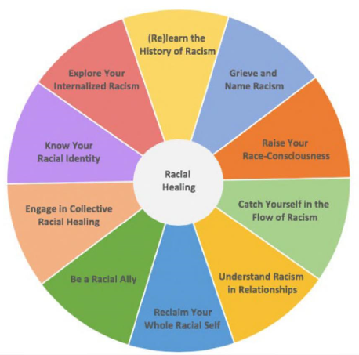
Racial Healing
(Singh, 2019)

Slide 25
How to (Racially) Heal …
Know Your Racial Identity: Explore what you know about your racial identity and what you were taught (or not taught) about race and racism.
Explore Your Internalized Racism: Identify belief systems about race and racism that aren’t yours, and develop new and more helpful thoughts and feelings.
(Re)learn the History of Racism: Discover new knowledge and gain a new understanding about racism and how this system of oppression works.
Grieve and Name Racism: Acknowledge the stages of grief that come with more awareness, learning, and action on racism.
Raise Your Race-Consciousness: Learn how to act more consciously as a racial being and be a positive influence on others to do the same
(Singh, 2019)

Slide 26
How to (Racially) Heal … continued …
Catch Yourself in the Flow of Racism: Understand that racism can arise in spontaneous and unexpected ways, and develop skills to interrupt these instances.
Understand Racism in Relationships: Recognize how racism plays out in interpersonal relationships across a variety of settings and learn to identify when it is happening.
Reclaim Your Whole Racial Self: Honor the ways you have changed and the authenticity that comes with individual racial healing.
Be a Racial Ally: Learn ways you can help others and work for racial justice.
Engage in Collective Racial Healing: Find ways to build circles of accountability and support for community racial healing.
(Singh, 2019)

Slide 27
Group Therapy

Slide 28
People of Color Groups: Culture-specific group vs. encompassing groups
Most of the research that I read tended to focus on people of color experiences in mixed groups or groups that were focused one specific populations such as Native Americans or Latinx people.
Provide snap shots of important considerations
Share my experience in putting this group together, incorporating my lived experience and including the group’s general composition and its impact on group functioning

Slide 29
Group Counseling With Native Americans
Native Traditions
Harmony Ethic
Nonaggressive and Noncompetitive approach to life
Intermediaries
Reciprocity and the practice of generosity
A belief in immanent justice
(Garrett, 2004)
Notes:
Harmony Ethic – Essence of Native beliefs. Guides both the beliefs and behaviors of Native People in the communal spirit of cooperation and contribution.
Nonaggressive/Noncompetitive – competition to benefit family/clan/tribe is acceptable; competition for personal gain is frowned upon.
Intermediaries – a way to minimize face-to-face hostility and can be facilitated by a respected member of the community
Reciprocity – Respectfully giving and of receiving is necessary for proper functioning of the community
Immanent Justice – Relieves feelings of wanting to control others; Natural order to things and Indian saying: “Never speak ill of someone because the wind will carry to that person and return on the wind to you 7 X stronger.”

Slide 30
Group Counseling With Native Americans
Native Traditions
Entering the Circle
Traditional Native perspective AND Contemporary therapeutic perspectives
“Healing Circle” or “Talking Circle”
Walking the Path Together – Level of acculturation (informal) assessment
Values
Geographic origin/residence
Tribal affiliation
(Garrett, 2004)

Slide 31
Group Counseling With Native Americans
Native Traditions
Recommendations
Sociodemographics
Physiology
Historical Context
Acculturation/Identity
Isolation/Social Connectedness
Generational Splits
Coping Mechanisms
Noninterference
(Garrett, 2004)
Notes:
Unemployment, inadequate housing, low educational levels, poverty levels, isolated living conditions.
Regular physical check-ups and blood tests.
Exploitation through discrimination, assimilation, relocation, disruption of familial and cultural patterns.
Cultural themes of belonging, independence, mastery, generosity. Where do you belong? What are you good at? What are your sources of strength?
Social events, family gatherings, powwows.
Acting as or learning from elders.
Learning other methods of dealing with stress, boredom, powerlessness, discrimination.
Address this possible “avoidance” if it becomes destructive.

Slide 32
An Afrocentric Approach to Counseling Groups with African Americans
UBUNTU
I am because we are; and because we are, therefore I am.
- Mibiti
Notes:
Being South African and transitioning to USA and the concept of Ubuntu living on in interpersonal interactions and role as therapist.

Slide 33
An Afrocentric Approach to Counseling Groups with African Americans
African-Centered Values
Spirituality
Movement
Affect
Communalism
Orality
Socially Defined
African-Centered Values
Time Perspective
Cooperation
Mutual Respect
Emotional Vitality
Racial Identity
Gender Issues
(Pack-Brown, 2004)

Slide 34
An Afrocentric Approach to Counseling Groups with African Americans
African-Centered Values
Racial Identity
Critical focus on acculturation, ethnicity, and race in African American group work
Strong racial identity = high self-esteem/self-clarity/differences in others
Racial Identity Development (RID)
4 Statuses
Progress through these stages influences African Americans group members:
Cognitive
Emotional
Physical behaviors
(Pack-Brown, 2004)

Slide 35
An Afrocentric Approach to Counseling Groups with African Americans
Diversity-Competent Group Leaders
Beliefs and Attitudes
Knowledge
Skills
(Pack-Brown, 2004)
Notes:
Awareness of personal beliefs, attitudes, and biases about the AA population and sensitivity to how these may influence one’s work with aa clients; development of an appreciation for AA culture; attitude of comfort, challenge, and satisfaction.
Understanding of the history, traditions, and values of AA culture, awareness of African-centered views of mental health, life adjustment, and helping; sensitivity to institutional barriers and prejudices; and matching of therapeutic approaches according to needs and backgrounds of AA.
Flexibility in utilizing approaches; effective communication by using appropriate language and non-verbal behaviors; familiarity of resources, programs, agencies appropriate for AA.

Slide 36
Group Counseling With Asians
General Considerations About Asian Americans
Intergroup Differences
Intergroup Conflict
Intragroup Differences
(Chung, 2004)
Notes:
Intergroup Differences – Not all Asians are the same
Intergroup Conflict – Japanese and Chinese in the same group could result in not working together or being respectful of others – sociopolitical and historical backgrounds
Intragroup Differences – Southeast Asians have 5 groups and immigration dates and periods of time is important to consider.

Slide 37
Group Counseling With Asians
Racial/Ethnic Identity of Group Leaders
Awareness of own and group members’ racial/ethnic identities
Racial/ethnic identities affects group dynamics and process
Must undergo in-depth analysis of own racial/ethnic identities
Examination of personal prejudices, stereotypes and biases
Accept concept of White Privilege
Identify and develop awareness of countertransference issues – e.g. Asian men might have a problem with female group leaders if coming from male-dominated cultures.
(Chung, 2004)

Slide 38
Group Counseling With Asians
Considerations for the Role of the Group Leader
Might require modification when working with this population
May need to be in role of expert, educator, problem solver, information giver etc.
May require greater structure with more directness and less passive leadership role
Expression of emotions is not easy, creation of nonthreatening and safe group environment
Confidentiality is very important, reduces fear and anxiety
May need to self-disclose as role-modeling, however, caution not to overuse
(Chung, 2004)

Slide 39
Psychoeducational and Counseling Groups with Latinx Students
Group Work With Latinx Students
Pre-group Planning
Group Size
Resistance
Leader Culture-Specific Knowledge and Self-Knowledge
(Rivera, 2004)
Notes:
Group size - Remain small in size of group; limit number of interaction and maximize the intervention effectiveness
Resistance – honest expression of feelings and hostility towards group leaders. Might think that therapy is for “crazy” people, instead use counseling or just group.
Leader – Leader’s mental set includes attitudes, values, beliefs, perceptions, opinions, and ides. Also able to know how to modify, deal with difficulties, and understand how culturally different people conceptualize and resolve problems

Slide 40
Psychoeducational and Counseling Groups with Latinx Students
Interventions
Listening
Understanding and Responding
(Rivera, 2004)

Slide 41
Psychoeducational and Counseling Groups with Latinx Students
Behavioral Change
Conventional vs Latinx
Specific/Measurable vs Task/Psychoeducational
“Change must be seen from a culture-specific perspective ad not only as a quantitative/absolute behavior modification on the part of the client.”
(Rivera, 2004)

Slide 42
How the USF People of Color Group came into existence
Proposing the group
Filling the group
Content, Activities, Process
Important things I learned

Slide 43
USF Counseling Center People of Color Group – Our Voices
Introductory Group Exercises – Volunteers … COME ON DOWN!
Initial Impressions
blank sheet of paper, tape, pen, trust, reflection …
The Big 5
white dry erase board, markers, eraser, trust, reflection …

Slide 44
References
Bentley-Edwards KL, Chapman-Hilliard C. Doing race in different places: Black racial cohesion on Black and White college campuses. Journal of Diversity in Higher Education. 2015;8(1):43-60. doi:10.1037/a0038293.
Chung, R.C-Y. (2004). Group Counseling With Asians. DeLucia-Waack, J. L., Gerrity, D. A., Kalodner, C. R., & Riva, M. T. (Eds.). Handbook of group counseling and psychotherapy. (pp. 200-212). Sage Publications Ltd. https://doi.org/10.4135/9781452229683
Garret, M.T. (2004). Sound of the Drum, Group Counseling with Native Americans. DeLucia-Waack, J. L., Gerrity, D. A., Kalodner, C. R., & Riva, M. T. (Eds.). Handbook of group counseling and psychotherapy. (pp. 169 -182). Sage Publications Ltd. https://doi.org/10.4135/9781452229683
Pack-Brown, S.P. (2004). An Afrocentric Approach to Counseling Groups With African Americans. DeLucia-Waack, J. L., Gerrity, D. A., Kalodner, C. R., & Riva, M. T. (Eds.). Handbook of group counseling and psychotherapy. (pp. 183-199). Sage Publications Ltd. https://doi.org/10.4135/9781452229683
Rivera, E.T. (2004). Psychoeducational and Counseling Groups With Latinos. DeLucia-Waack, J. L., Gerrity, D. A., Kalodner, C. R., & Riva, M. T. (Eds.). Handbook of group counseling and psychotherapy. (pp. 213-223). Sage Publications Ltd. https://doi.org/10.4135/9781452229683
Sinanan A. The value and necessity of mentoring African American College students at PWI’s. Journal of Pan African Studies. 2016;(8):155. http://search.ebscohost.com/login.aspx?direct=true&db=edsglr&AN=edsgcl.472680614&site=eds-live. Accessed February 24, 2020.
Singh, Anneliese A.. The Racial Healing Handbook : Practical Activities to Help You Challenge Privilege, Confront Systemic Racism, and Engage in Collective Healing, New Harbinger Publications, 2019. ProQuest Ebook Central, https://ebookcentral.proquest.com/lib/usf/detail.action?docID=5820417.
Von Robertson, R., Bravo, A., & Chaney, C. (2016). Racism and the Experiences of Latina/o College Students at a PWI (Predominantly White Institution). Critical Sociology, 42(4–5), 715–735. https://doi.org/10.1177/0896920514532664

Slide 45
Questions? Comments? Reflections?

